Slide 1
Facial Recognition
Microprocessor Systems Project
Alexandru Racovan
Stefania Santimbrean

Slide 2
An IoT project using Python and Raspberry Pi

Slide 3
Description
The project presented is a client-server application which detects the face through a webcam. The raspberry pi has a webcam connected to it. When the application starts, video streaming is captured by the webcam and the data is sent to the server, which processes it and send tweets and logs off the user from the computer, if it recognizes the object to be a face.

Slide 4
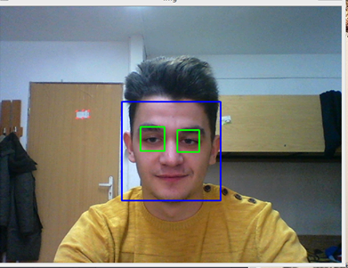
Detecting the face

Slide 5
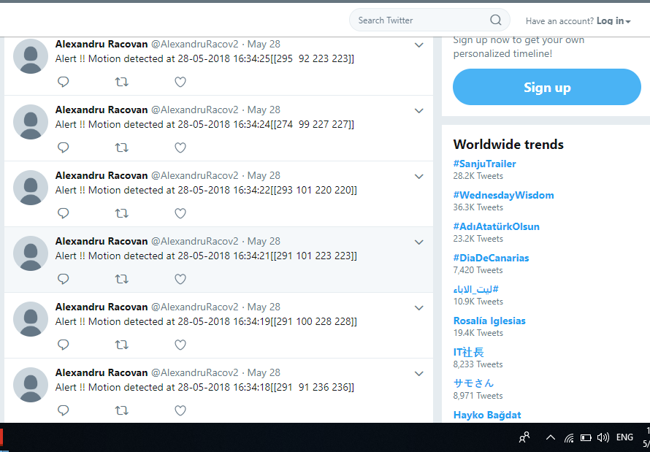
Twitter

Slide 6
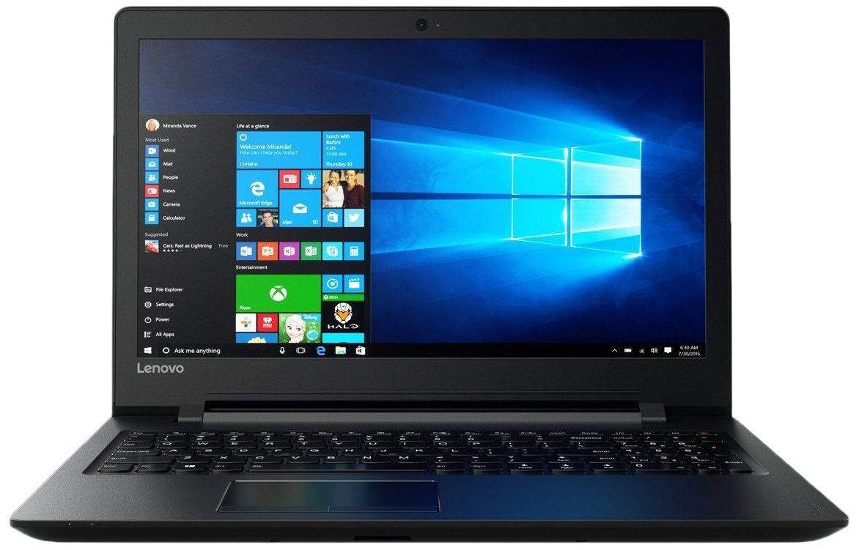
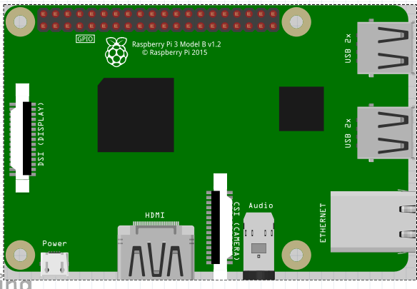

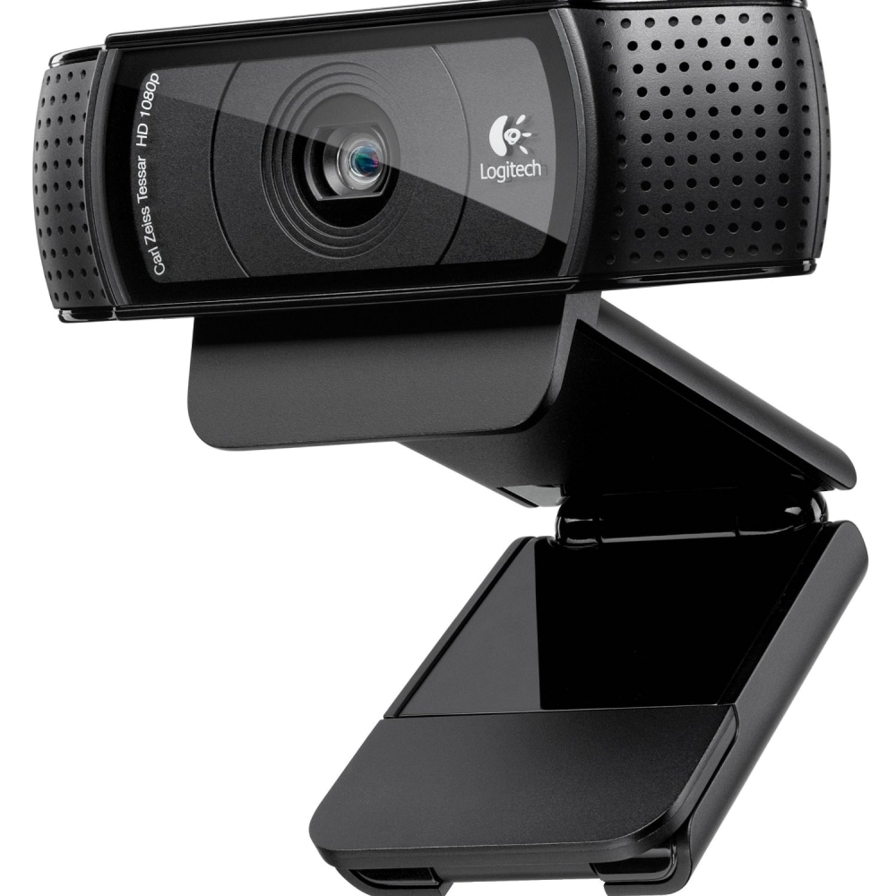
Scheme

Slide 7
We used:
Python
Raspberry Pi
Webcam
Client-Server Model
Network Socket
NumPy
OpenCV
Haar Cascades
Pickle - Python object serialization

Slide 8
About OpenCV
OpenCV (Open Source Computer Vision Library) is an open source computer vision and machine learning software library. OpenCV was built to provide a common infrastructure for computer vision applications and to accelerate the use of machine perception in the commercial products. The library has more than 2500 optimized algorithms, which includes a comprehensive set of both classic and state-of-the-art computer vision and machine learning algorithms. These algorithms can be used to detect and recognize faces, identify objects, which is why we used it in the algorithm.

Slide 9
Face Detection using Haar Featured-based Cascade Classifiers
Object Detection using Haar feature-based cascade classifiers is an effective object detection method. It is a machine learning based approach where a cascade function is trained from a lot of positive and negative images. It is then used to detect objects in other images.
We will work with face detection.

Slide 10
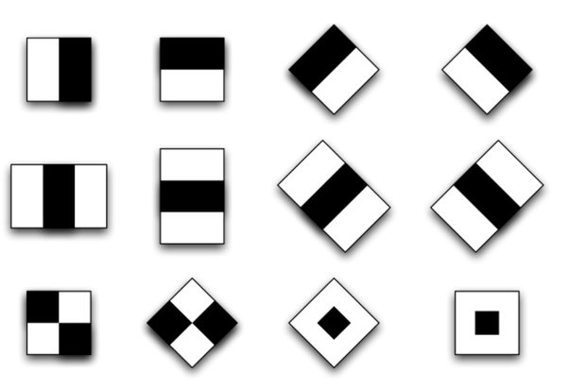
Initially, the algorithm needs a lot of positive images (images of faces) and negative images (images without faces) to train the classifier. Then we need to extract features from it. For this, haar features shown in the image are used. They are just like our convolutional kernel. Each feature is a single value obtained by subtracting sum of pixels under white rectangle from sum of pixels under black rectangle. Now all possible sizes and locations of each kernel is used to calculate plenty of features.

Slide 11
Pickle
We use Pickle to send the data received from the Webcam to the server. The pickle module implements a fundamental, but powerful algorithm for serializing and de-serializing a Python object structure. “Pickling” is the process whereby a Python object hierarchy is converted into a byte stream, and “unpickling” is the inverse operation, whereby a byte stream is converted back into an object hierarchy. Pickling (and unpickling) is alternatively known as “serialization”, “marshalling,” or “flattening”, however, to avoid confusion, the terms used here are “pickling” and “unpickling”.

Slide 12
Thank you!

